Slide 1
Means- End Analysis

Slide 2
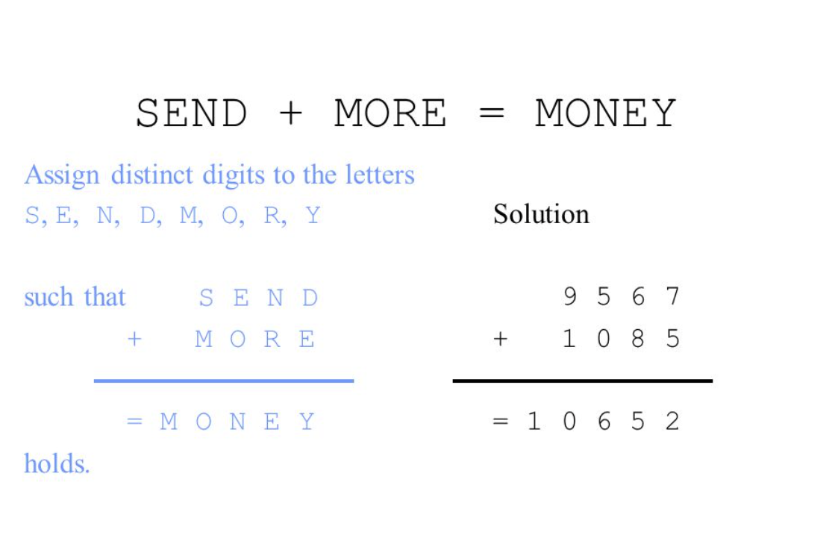

Slide 3
CROSS
+ ROADS
DANGER
96233
62513
158746
TWO
TWO
FOUR

Slide 4
EAT
+THAT
APPLE
MATH
+MYTH
HARD
COMPLEX
+LAPLACE
CALCULUS
TOUGH
+DOUGH
RHYME

Slide 5
YOUR
YOU
HEART
TO
GO
OUT
BASE
BALL
GAMES

Slide 6
Means-Ends Analysis is problem-solving techniques used in Artificial intelligence for limiting search in AI programs.
It is a mixture of Backward and forward search technique.
The MEA technique was first introduced in 1961 by Allen Newell, and Herbert A. Simon in their problem-solving computer program, which was named as General Problem Solver (GPS).
The MEA analysis process centered on the evaluation of the difference between the current state and goal state.

Slide 7
Step 1: Compare CURRENT to GOAL, if there are no differences between both then return Success and Exit.
Step 2: Else, select the most significant difference and reduce it by doing the following steps until the success or failure occurs.
Select a new operator O which is applicable for the current difference, and if there is no such operator, then signal failure.
Attempt to apply operator O to CURRENT. Make a description of two states.
i) O-Start, a state in which O’s preconditions are satisfied.
ii) O-Result, the state that would result if O were applied In O-start.
If
(First-Part <------ MEA (CURRENT, O-START)
And
(LAST-Part <----- MEA (O-Result, GOAL), are successful, then signal Success and return the result of combining FIRST-PART, O, and LAST-PART

